Slide 1

What is Redux

Slide 2
What is Redux
"Redux is the ultimate app sidekick! It helps keep all the important information and changes in your app organized and under control.
Picture a control room where all the data is stored and managed. And the best part? Redux has strict rules to make sure everything is updated smoothly and consistently.
So, if you want your app to run like a well-oiled machine, just call on Redux - the trusty app sidekick that always gets the job done!"

Slide 3
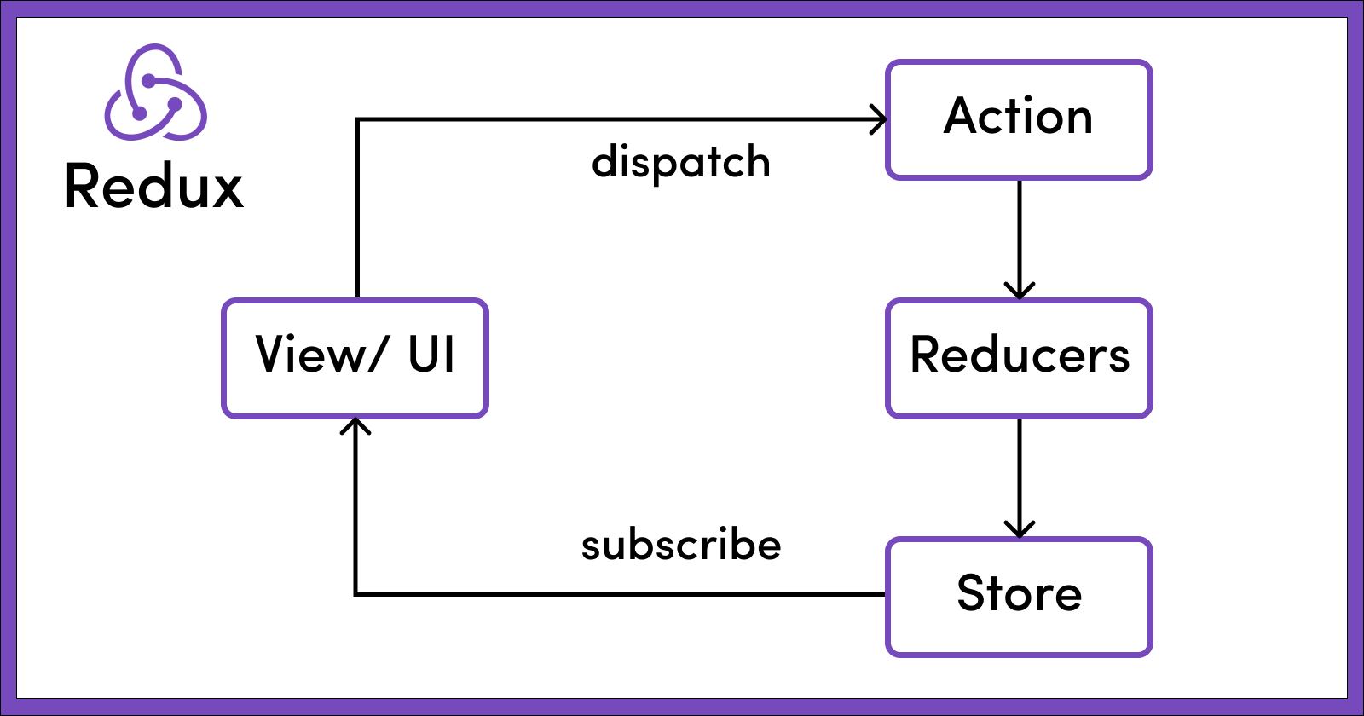
Why Should I Use Redux?
Get ready to join forces with the state management hero: Redux!
With Redux on your team, you'll be able to keep all the important information in your app organized and easily accessible, no matter where it's needed. Redux is like a roadmap for your code, making it crystal clear when and how your app's information is changing.
And don't worry, Redux will help you write code that's predictable and easy to test, giving you the confidence that your app will always perform like a champion! Get ready to conquer the state management game with Redux!

Slide 4
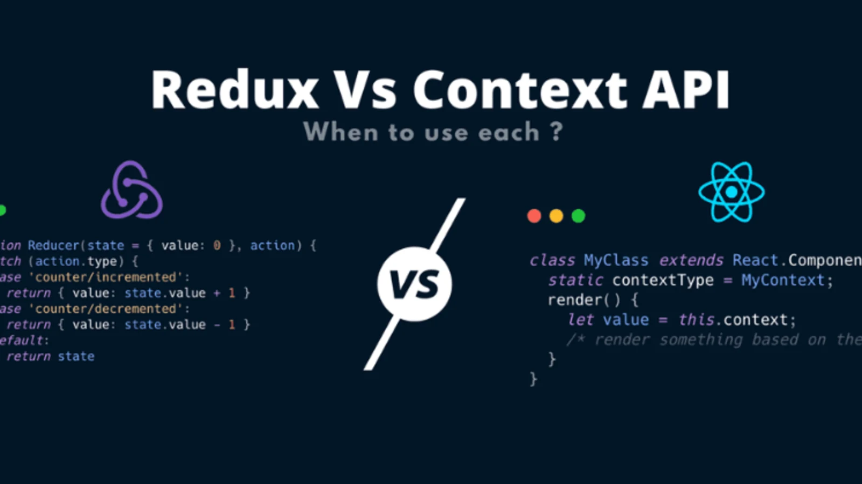
When Should I Use Redux?
Sure, it comes with its own set of tradeoffs. There are more concepts to learn and more code to write. And yes, it adds some indirection to your code and requires you to follow certain restrictions. But trust us, the benefits are totally worth it!
Redux is especially useful when you're dealing with large amounts of application state that need to be accessed in multiple places. And if your app state is constantly being updated and the logic behind those updates is complex, Redux has got you covered!
But don't take our word for it - think about the kind of app you're building. If you're working with a medium or large-sized codebase and collaborating with other developers, then Redux might be the way to go. However, not all apps require Redux, so take some time to weigh your options and decide which tools will help you solve the problems you're working on.
So, are you ready to take your state management skills to the next level? Give Redux a try and let it work its magic!

Slide 5

Redux Libraries and Tools
First up, we have the tried-and-true Redux library. It's a standalone JS library that's small but mighty. But what makes it even better is that it can integrate with other fantastic packages.
One such package is React-Redux, which is perfect for those who are already using React. It allows your React components to interact with a Redux store by reading state pieces and dispatching actions. It's like a dynamic duo!
Next, we have the amazing Redux Toolkit, which we highly recommend for writing Redux logic. It contains essential packages and functions that help you build a Redux app with best practices in mind. It simplifies many tasks, prevents common mistakes, and streamlines the development process. Think of it as your trusty sidekick!
Last but not least, we have the Redux DevTools Extension. It's a debugging tool that helps you see a history of changes made to the state in your Redux store over time. This makes it easy to troubleshoot issues and use powerful techniques like "time-travel debugging".
These Redux libraries and tools can make your app development journey smoother and more efficient. So why not give them a try and see how they can level up your game?

Slide 6
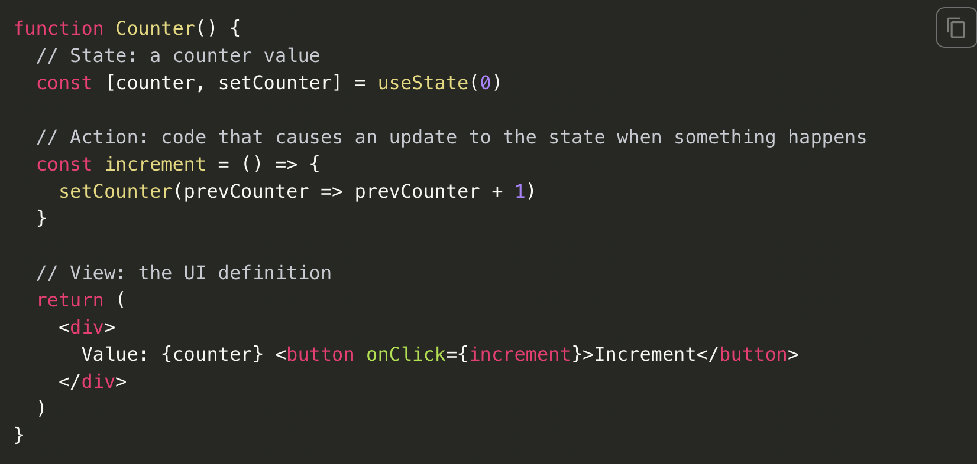
Redux Terms and Concepts
State Management
Let's start by looking at a small React counter component. It tracks a number in component state, and increments the number when a button is clicked:

Slide 7
Redux Terms and Concepts
First up, we have the state - it's the source of truth that drives our app. Think of it like the engine of the machine - it's what makes everything run smoothly.
Next, we have the view - it's a declarative description of the user interface based on the current state. It's like the chassis of the machine - it provides structure and support for everything else.
Last but not least, we have the actions - they're the events that occur in the app based on user input, and trigger updates in the state. It's like the fuel that keeps the machine going - without actions, the state and view would be stuck in one place.

Slide 8
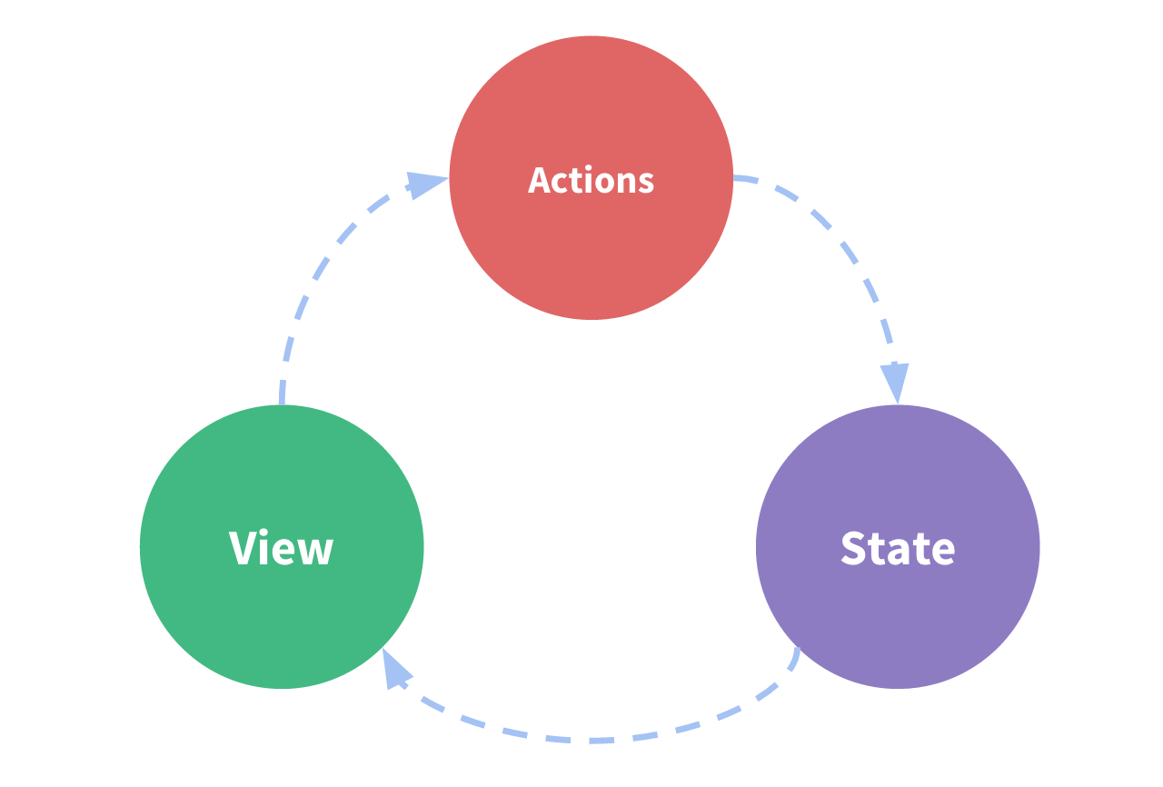
Redux Terms and Concepts
let's dive deeper into state management and the challenges that come with it. We've all been there - when simple state management turns into a tangled mess with multiple components trying to use and share the same state. It can be like a game of Jenga - one wrong move and everything falls apart.
One solution is to "lift state up" to parent components, but that can only take you so far. What we really need is a way to extract the shared state from the components and put it in a centralized location outside the component tree. That way, any component can access the state or trigger actions, no matter where they are in the tree.
And that's where Redux comes in! It's the single centralized place to contain the global state in your application. By defining and separating the concepts involved in state management and enforcing rules that maintain independence between views and states, we give our code more structure and maintainability. It's like having a designated parking spot for your state, with clear guidelines for how to access and update it.
So, what are these specific patterns we follow when updating the state? They're the Redux way - a set of rules and conventions that make your code more predictable and easier to maintain. It's like having a map that guides you to your destination, without getting lost in the weeds.

Slide 9
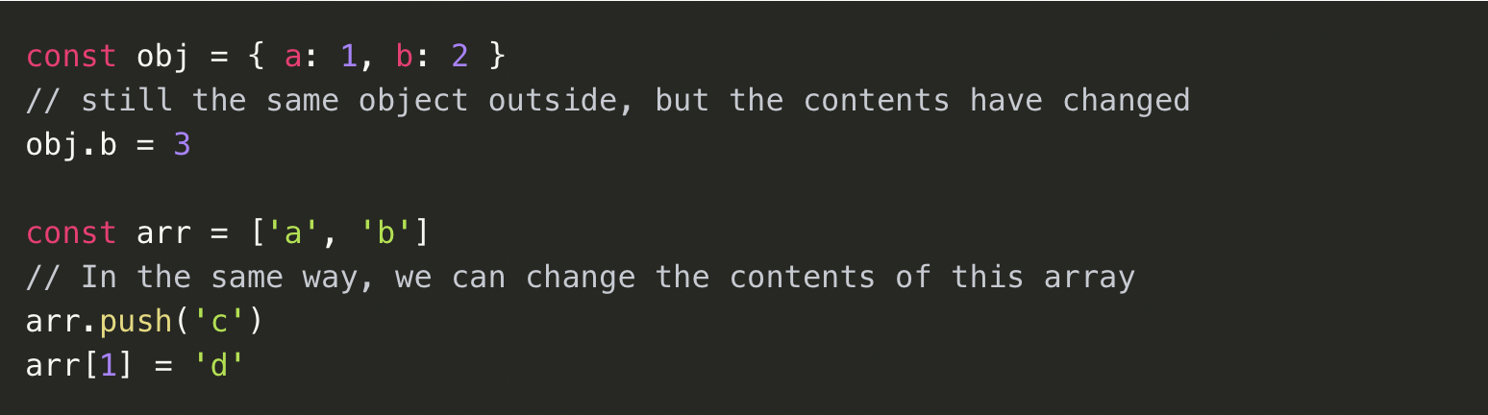
Immutability
Mutable means changeable, while immutable means unchangeable. JavaScript objects and arrays are mutable by default, allowing you to modify their contents.
Now, let's apply this to JavaScript objects and arrays. By default, these data structures are mutable. This means that if you create an object, you can change the contents of its fields. Similarly, if you create an array, you can change the contents as well.
It's like having a whiteboard - you can write something down and then erase it or change it later if needed. However, sometimes you might want to have a permanent record that can never be altered. That's where immutability comes in handy.

Slide 10
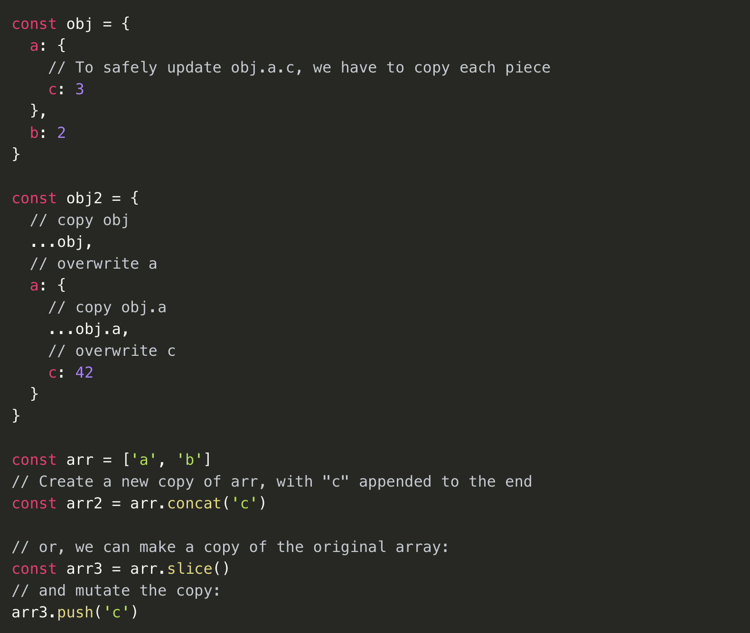
Immutability
To update values immutably, we need to make copies of our existing objects and arrays and then modify those copies. But don't worry, it's not as complicated as it sounds! We can use some handy tools in JavaScript to help us out.
One of these tools is the array/object spread operator. It allows us to make a copy of an array or object and then modify it without changing the original data. It's like making a photocopy of a document - you can write on the copy without affecting the original.
We can also use array methods that return new copies of the array instead of mutating the original. It's like creating a duplicate of a Lego set - you can build something new with the pieces without breaking down the original creation.

Slide 11
Actions
In the simplest terms, an action is like an event that describes something that happened in your application.
To be considered an action, a plain JavaScript object must have a type field. This type field should be a string that gives the action a descriptive name, like "todos/todoAdded". We follow a convention where the first part of the type string is the feature or category that the action belongs to, and the second part is the specific thing that happened.
But actions can have more than just a type field. We can also include additional information about what happened in other fields of the object. By convention, we put this information in a field called payload. It's like a present that comes with your event - you can include more information about the action that happened.
So what does a typical action object look like? Well, it might include a type field with a descriptive name, and a payload field with additional information. It's like a mini history book of what happened in your application at a specific moment.

Slide 12
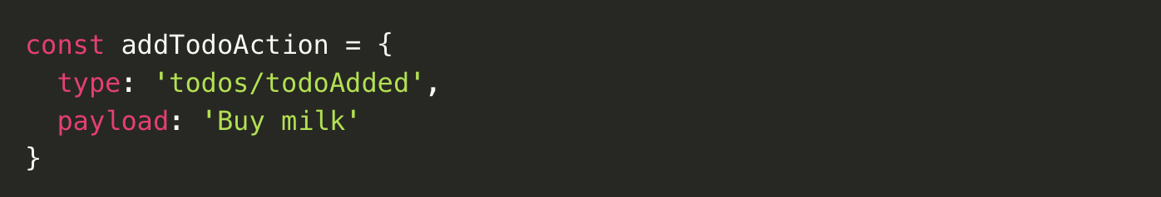
Actions
But actions can have more than just a type field. We can also include additional information about what happened in other fields of the object. By convention, we put this information in a field called payload. It's like a present that comes with your event - you can include more information about the action that happened.
So what does a typical action object look like? Well, it might include a type field with a descriptive name, and a payload field with additional information. It's like a mini history book of what happened in your application at a specific moment.

Slide 13
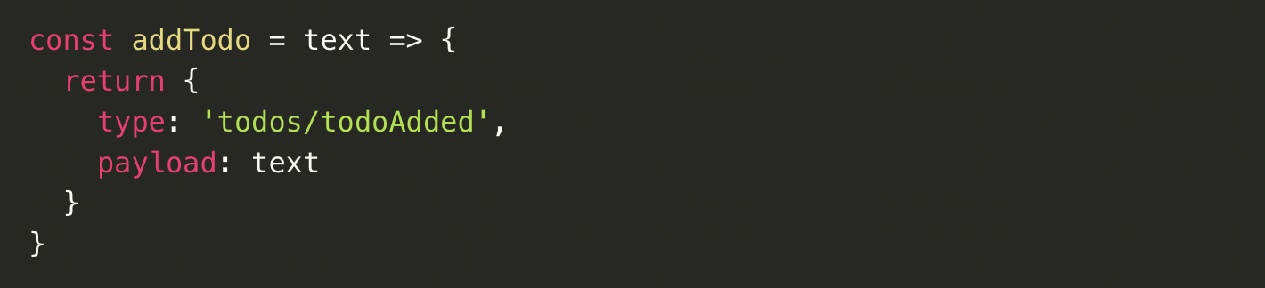
Action Creators
But actions can have more than just a type field. We can also include additional information about what happened in other fields of the object. By convention, we put this information in a field called payload. It's like a present that comes with your event - you can include more information about the action that happened.
So what does a typical action object look like? Well, it might include a type field with a descriptive name, and a payload field with additional information. It's like a mini history book of what happened in your application at a specific moment.

Slide 14

Reducers
It's a special function that takes in the current state and an action object, and decides how to update the state if necessary. You can think of a reducer as a super-powered event listener, kind of like a DJ who takes in requests and plays the right music based on what the crowd wants.
Reducers are named after the callback function you pass to the Array.reduce() method. But don't worry if you're not familiar with that - we'll cover everything you need to know!
There are some important rules that reducers must follow:
They should only calculate the new state value based on the state and action arguments
They're not allowed to modify the existing state directly - instead, they must make immutable updates by copying the existing state and making changes to the copied values.
They must not do anything asynchronous or cause any "side effects" - that's just bad manners.

Slide 15
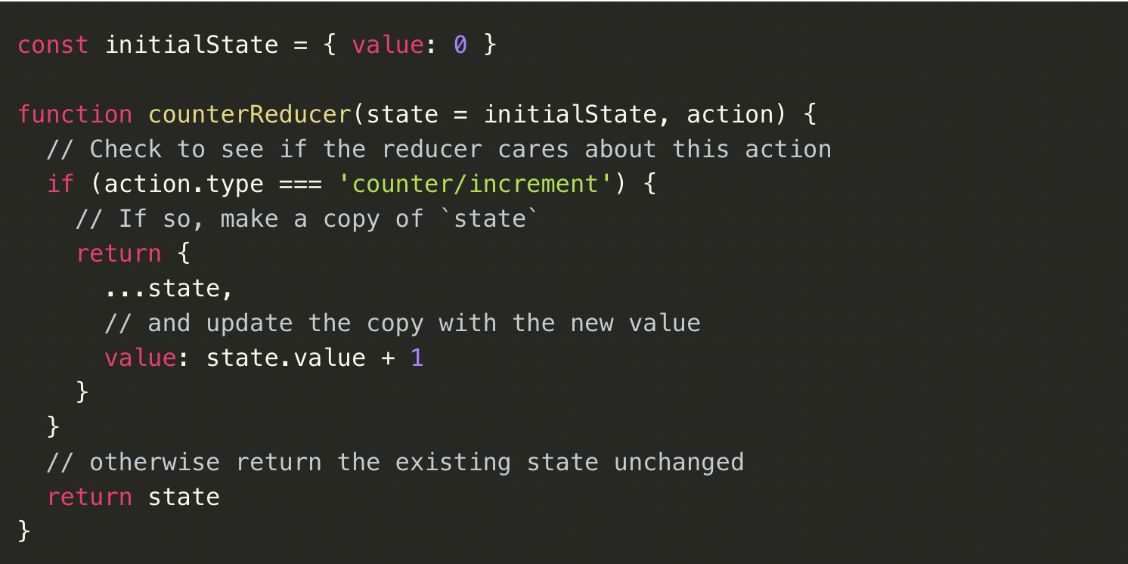
Reducers
But enough about the rules, let's talk about how reducers actually work. The logic inside reducer functions typically follows the same series of steps:
  Check to see if the reducer cares about the incoming action
  If so, make a copy of the state, update the copy with new values, and return it
Otherwise, return the existing state unchanged
So there you have it - reducers in a nutshell! We'll go over the rules in more detail later, but for now, let's get back to coding and creating some awesome apps. Keep on reducing, my friends!

Slide 16
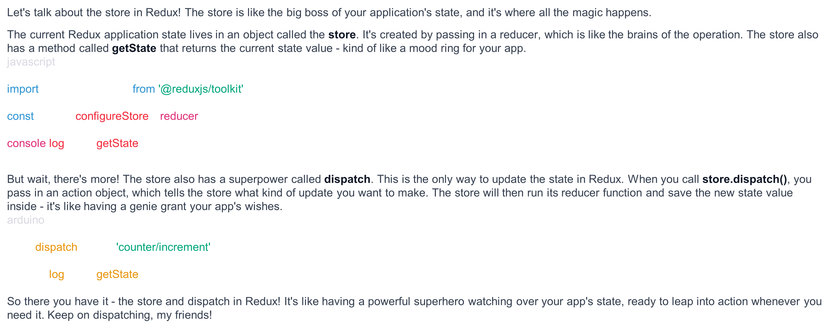
Store and Dispatch

Slide 17
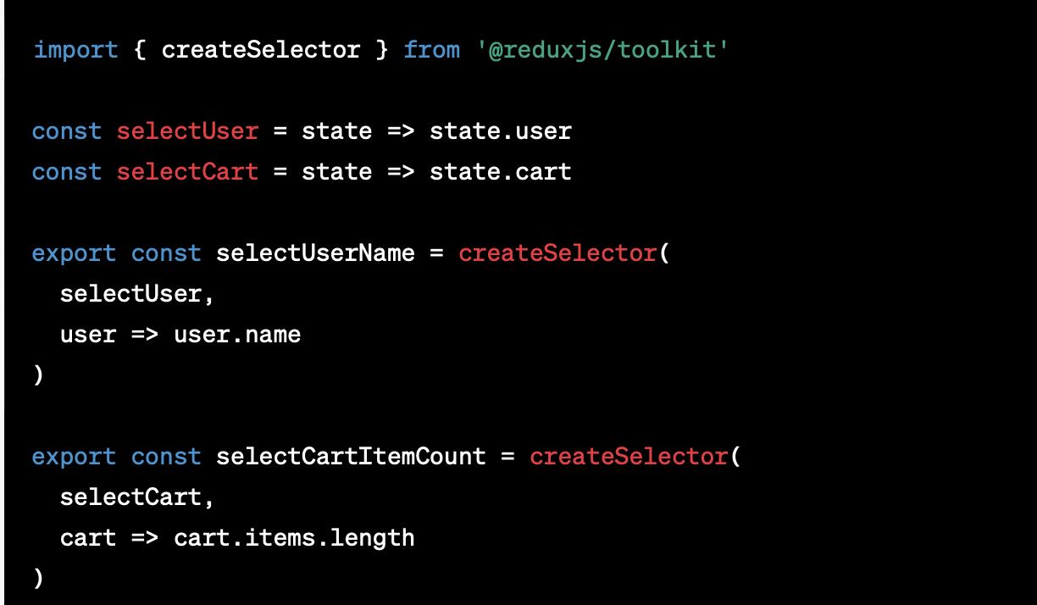
Selectors
These little functions are like detectives that know exactly how to extract specific pieces of information from your app's state.
As your app grows and gets more complex, selectors can help you avoid repeating logic over and over again. Instead of copying and pasting code all over your app, you can just use a selector to get the data you need from the store.
Selectors are like a Swiss Army knife for your app's state - they can handle all sorts of tasks. Need to get the user's name? There's a selector for that. Want to know how many items are in the cart? There's a selector for that too.

Slide 18
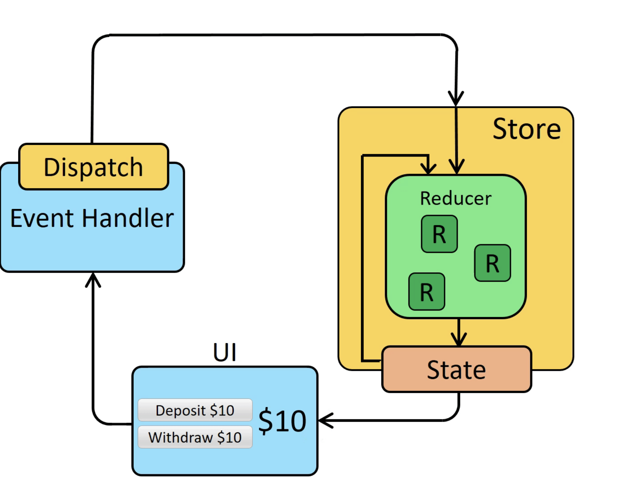
Application Data Flow
Remember when we talked about the "one-way data flow" earlier? It's time to dive deeper and see how Redux makes it all happen.
The first step is to set up our Redux store by creating a root reducer function. This function tells Redux how to handle all the actions in our application. Then, the store is created, and the root reducer is called once to set the initial state.
As the UI components are being rendered, they access the current state of the Redux store and use that data to decide what to render. They also subscribe to any future store updates so they can know if the state has changed.

Slide 19
Application Data Flow
Updates:
Something happens in the app, such as a user clicking a button
The app code dispatches an action to the Redux store, like dispatch({type: 'counter/increment'})
The store runs the reducer function again with the previous state and the current action, and saves the return value as the new state
The store notifies all parts of the UI that are subscribed that the store has been updated
Each UI component that needs data from the store checks to see if the parts of the state they need have changed.
Each component that sees its data has changed forces a re-render with the new data, so it can update what's shown on the screen.

